Slide 1
Multi Tone Vivado BD Breakdown

Slide 2
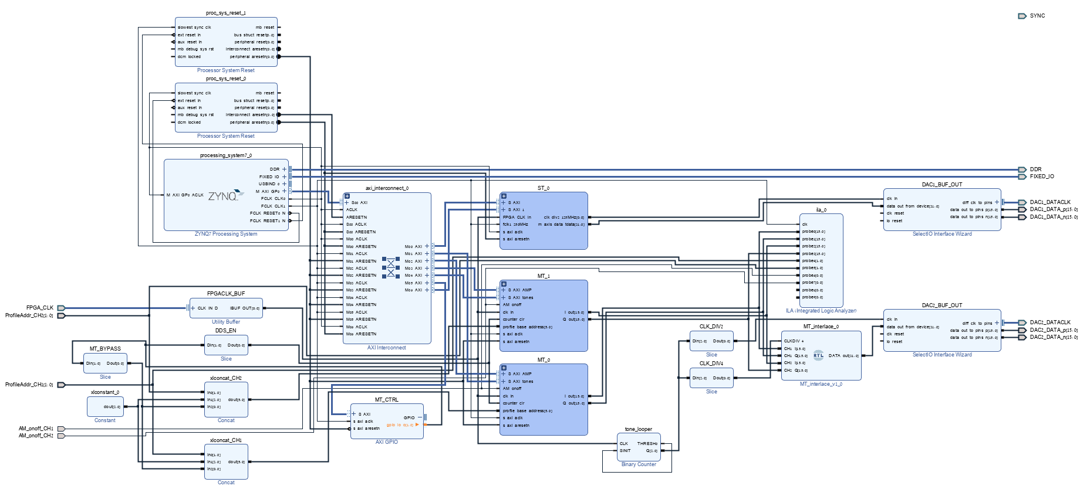
FPGACLK FROM CDCE = 250MHz
OUTPUTS DATA TO DAC2 WITH DATACLK= FPGACLK/2
Interleaves MT1 with MT0 so rising edge of FPGA_CLK/4: OUT = {CH1I,CH1Q} FALLINGEDGE: OUT= {CH2I,CH2Q}
CONTROLS BYPASS AND DDS_EN
CONNECTED TO FPGA_CLK and divides the clock
I/Os controlling ch1/2
Profile address[5:0]: {BYPASS, 000,PR1,PR0}

Slide 3
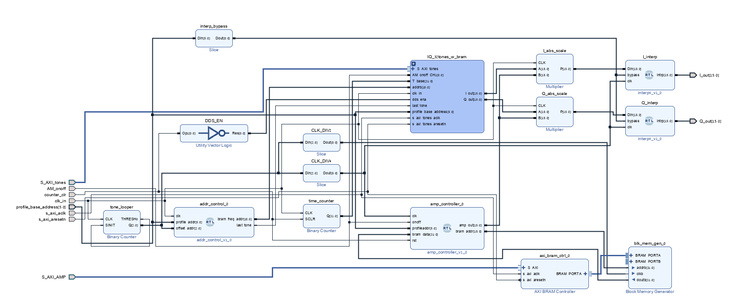
DOES (I/Q_OUT)*AMP
USE MULTS, SPEED OPTIMISED, 1 CYCLE DELAY. I/Q 16B SIGNED, AMP 16B UNSIGNED
SMOOTHS OUPUT USING INTERPOLATION OVER 4 SAMPLES
CLK_DIV2: BIT0
CLK_DIV4: BIT1
COUNTS 0 TO 7
CREATES THE TIME VECTOR FOR THE SINE
CHOOSES THE SIZE OF THE AMPLITUDE. SAVED IN BRAM AS AMP_PROFILES OF [NUM_STEPS, STEP_SIZE]. STEP SIZE COULD BE NEGATIVE TO REDUCE THE SIZE OF THE AMPLITUDE.

Slide 4
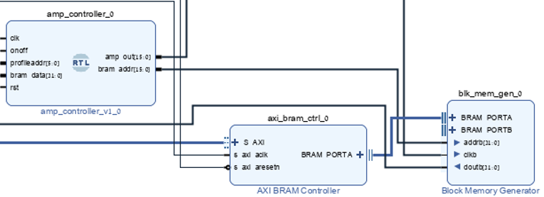
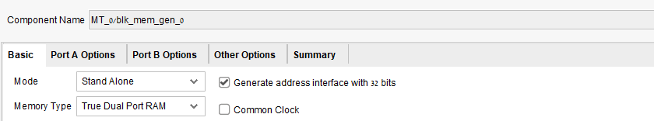
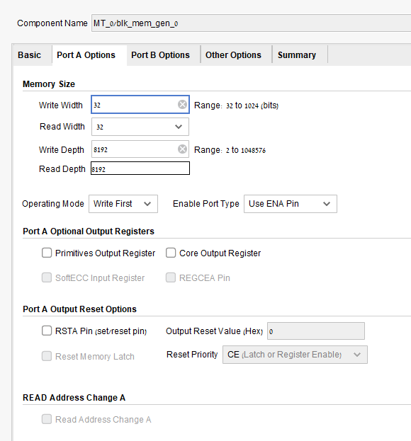
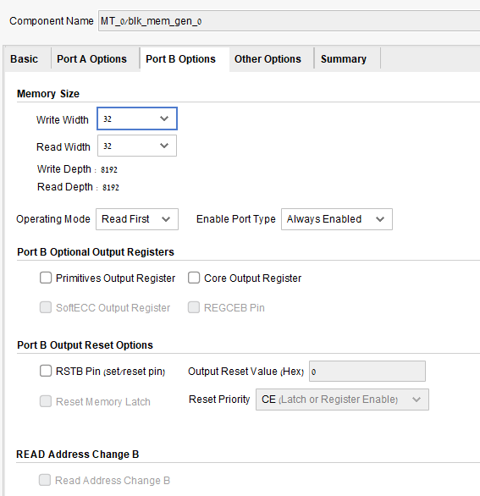
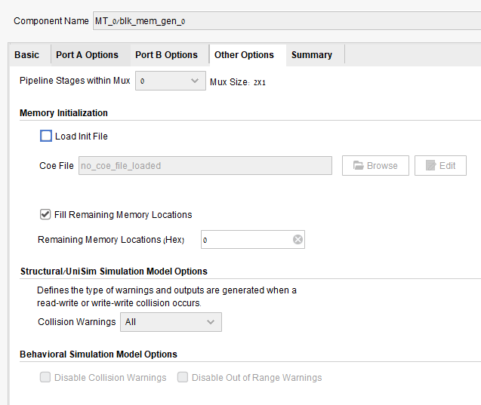

Slide 5
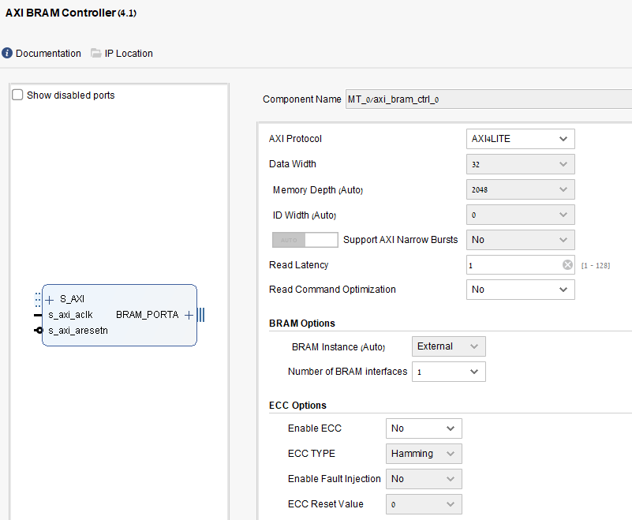

Slide 6
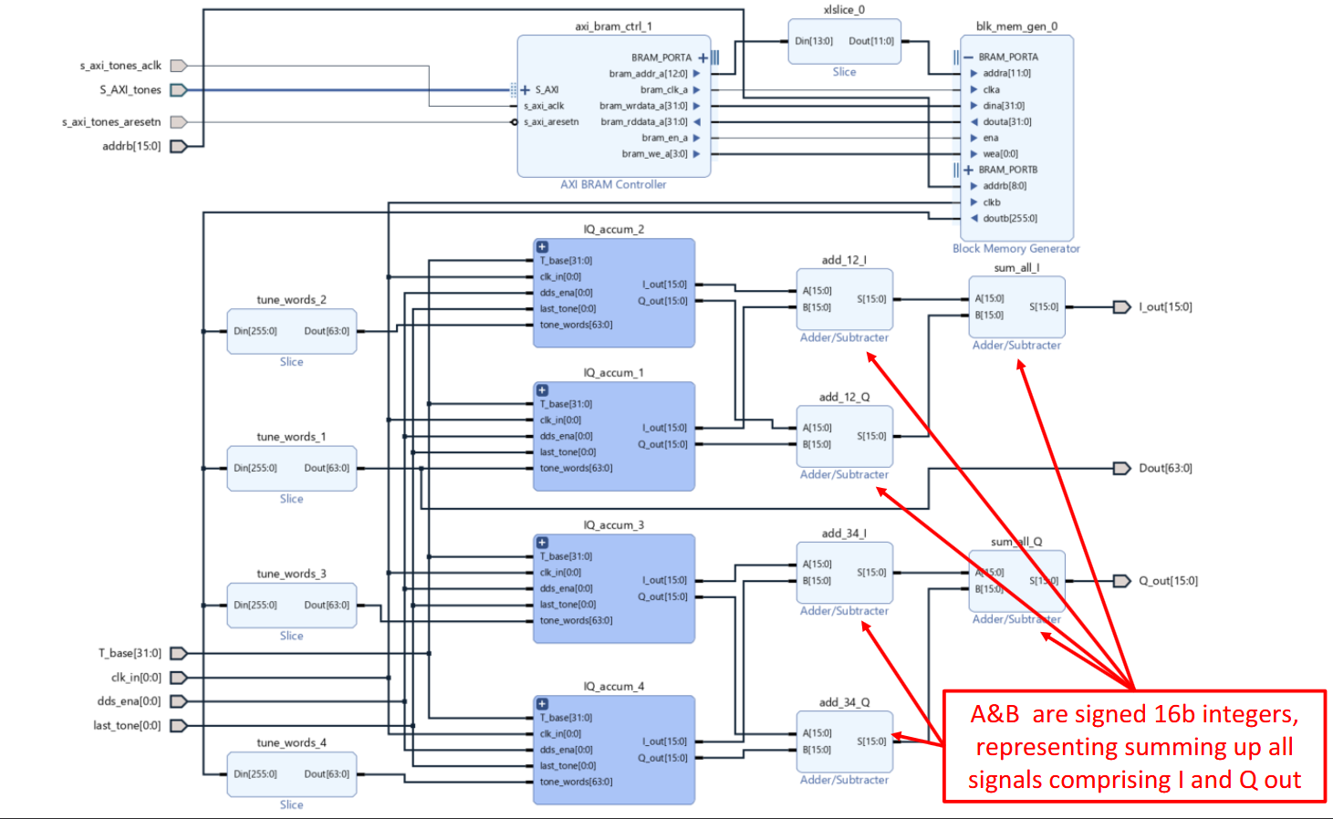
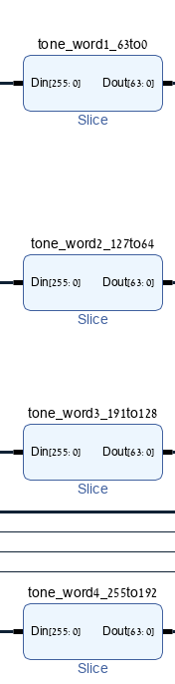
INSIDE SLICING OF EACH TONE WORD
SHOULD BE [14:0]. IN ADDRESS EDITOR: /MT_x/IQ_32tones_w_bram/axi_bram_ctrl_0/S_AXI SIZE SHOULD BE 32K

Slide 7
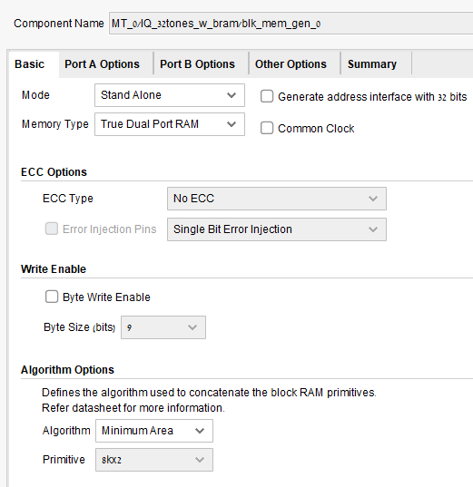
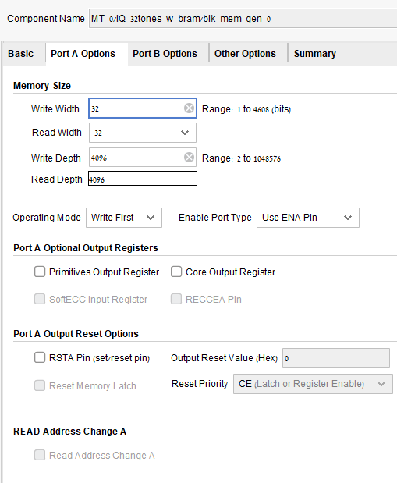
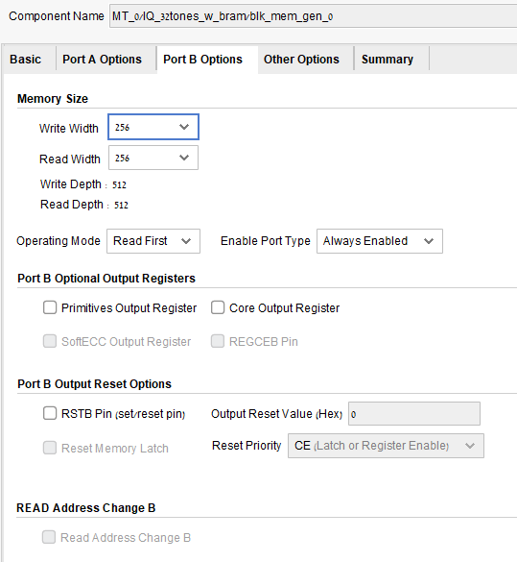
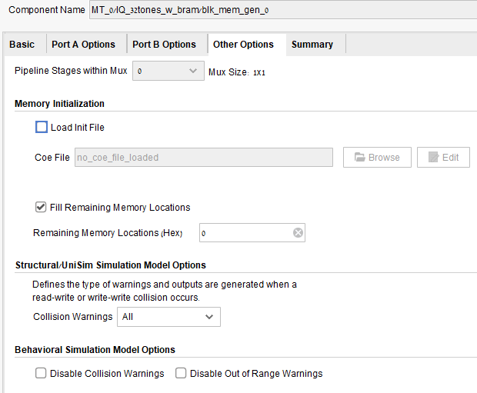

Slide 8
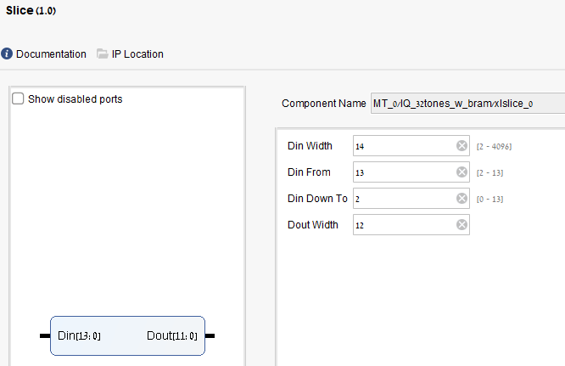
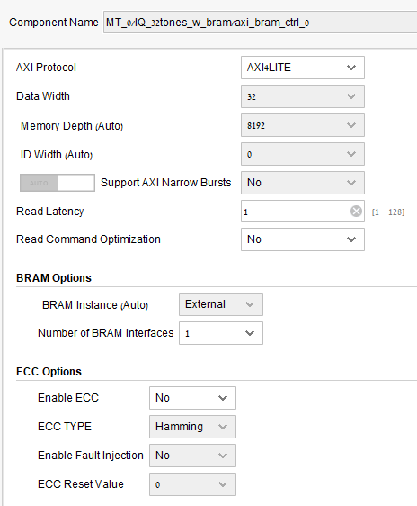

Slide 9
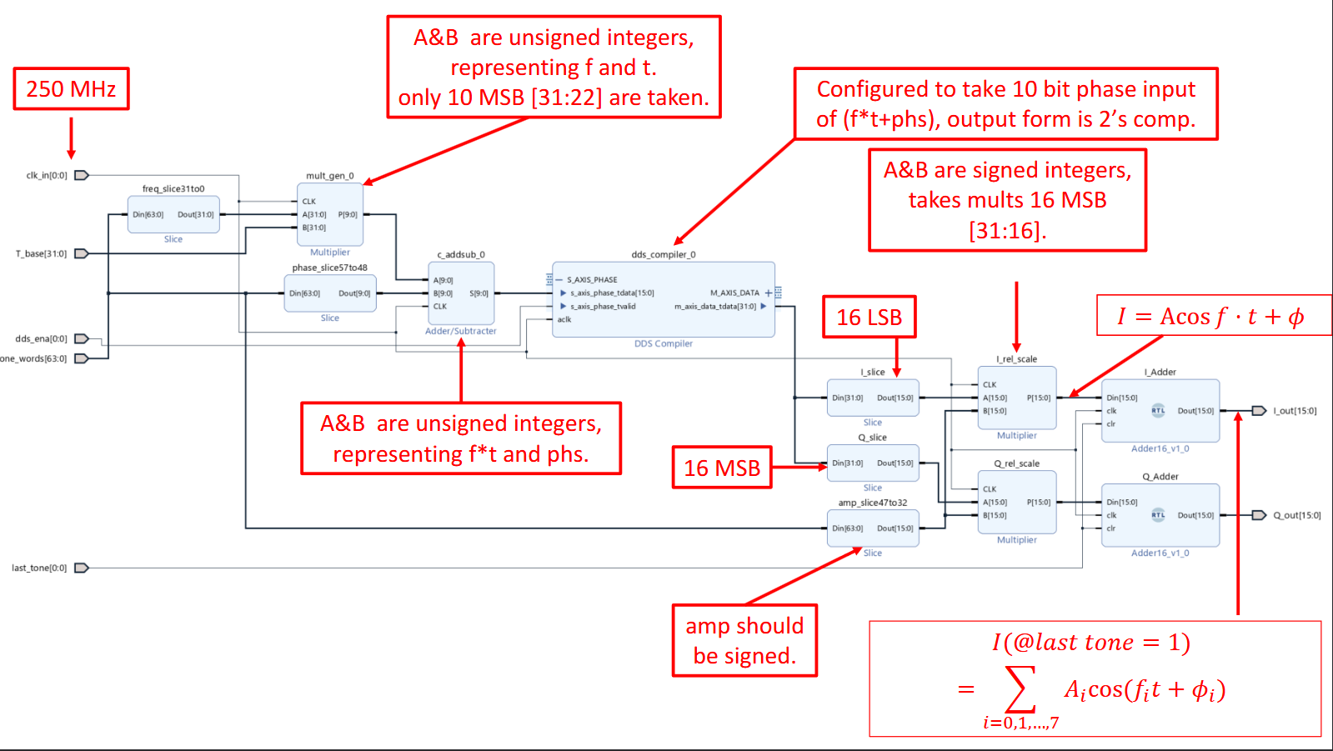
Delay 4 cycles, use mults, speed optimized
Delay 3 cycles
Delay 4 cycles, use mults, speed optimized
Phase delay may ne unsynced. Add an adder/substracter with 4 cycles delay to make it work.

